Slide 1
Introduction to Regression
-BRIAN THOMAS

Slide 2
Topics to be covered:
What is Regression?
Classification of Regression
Types of Regression Algorithms
What is a Scatter Plot?
What is a Fit Line?
Linear Regression Graph
Errors in Linear Regression
Model Evaluation Approaches

Slide 3
What is Regression?
Regression is a method to determine the statistical relationship between a dependent variable and one or more independent variables.

Slide 4
Types of Regression:
Regression
Simple Regression
Multiple Regression
Simple Non-Linear Regression
Simple Linear
Regression

Slide 5
Multiple Linear Regression:
Simple Linear Regression:
Only 1 Independent Variable (Input Variable) and 1 Dependent Variable (Output Variable).
To find a Relationship between 1 Input Variable and 1 Output Variable using a Linear Model
Also known as Bivariate Linear Regression
More than one (>1) Independent Variables (Input Variable) and one Dependent Variable (Output Variable).
To find a Relationship between Multiple Input Variables and 1 Output Variable using a Linear Model.
Also known as Multivariate Linear Regression

Slide 6
Types of Regression Algorithms:
Ordinal Regression
Poisson Regression
Fast Forest Quantile Regression
Linear, Polynomial, Stepwise Regression
Bayesian Linear Regression
Neural Network Regression
Ridge Regression
LASSO Regression (Least Absolute Selection and Shrinkage Operator)
Support Vector Regression.

Slide 7
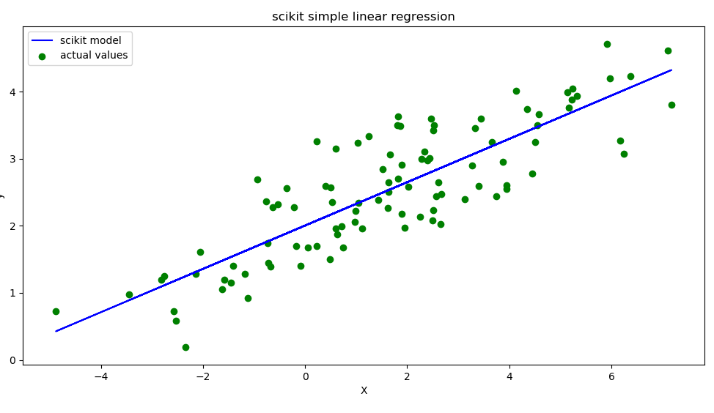
Basic Scatter Plot

Slide 8
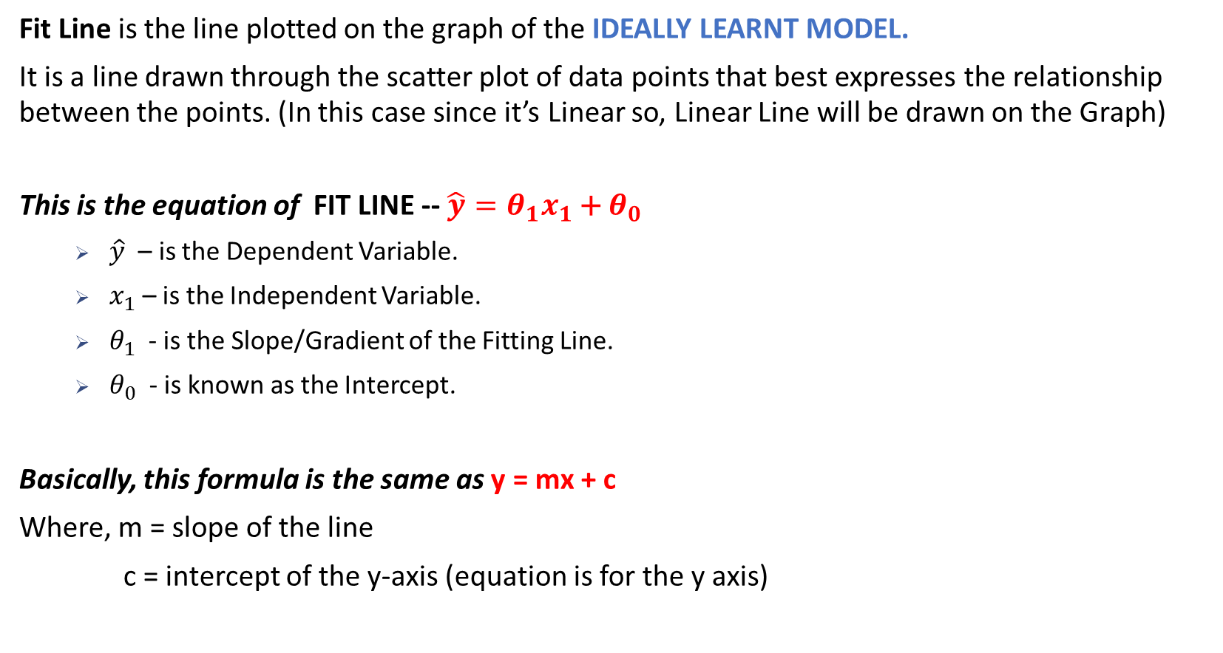
What is Fit Line / Line of Best Fit ?
Fit Line is the line plotted on the graph of the IDEALLY LEARNT MODEL.
It is a line drawn through the scatter plot of data points that best expresses the relationship between the points. (In this case since it’s Linear so, Linear Line will be drawn on the Graph)
This is the equation of FIT LINE -- $\hat{y}=θ_{1}x_{1}$ + $θ_{0}$
$\hat{y}$ – is the Dependent Variable.
$x_{1}$ – is the Independent Variable.
$θ_{1}$ - is the Slope/Gradient of the Fitting Line.
$θ_{0}$ - is known as the Intercept.
Basically, this formula is the same as y = mx + c
Where, m = slope of the line
c = intercept of the y-axis (equation is for the y axis)

Slide 9
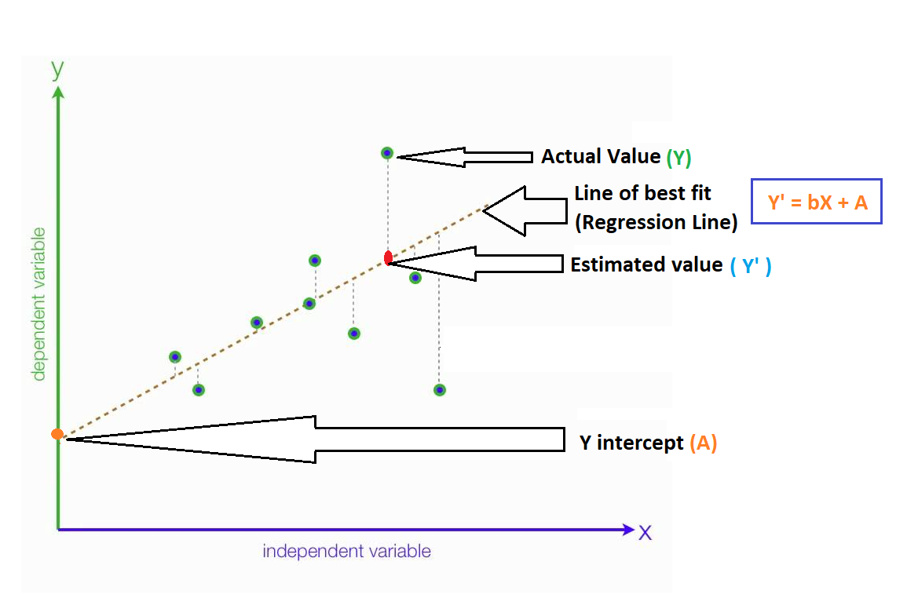
Linear Regression Graph

Slide 10
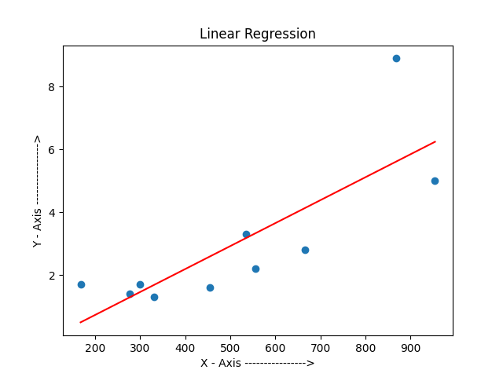
Another Example using manually calculated Fit Line

Slide 11
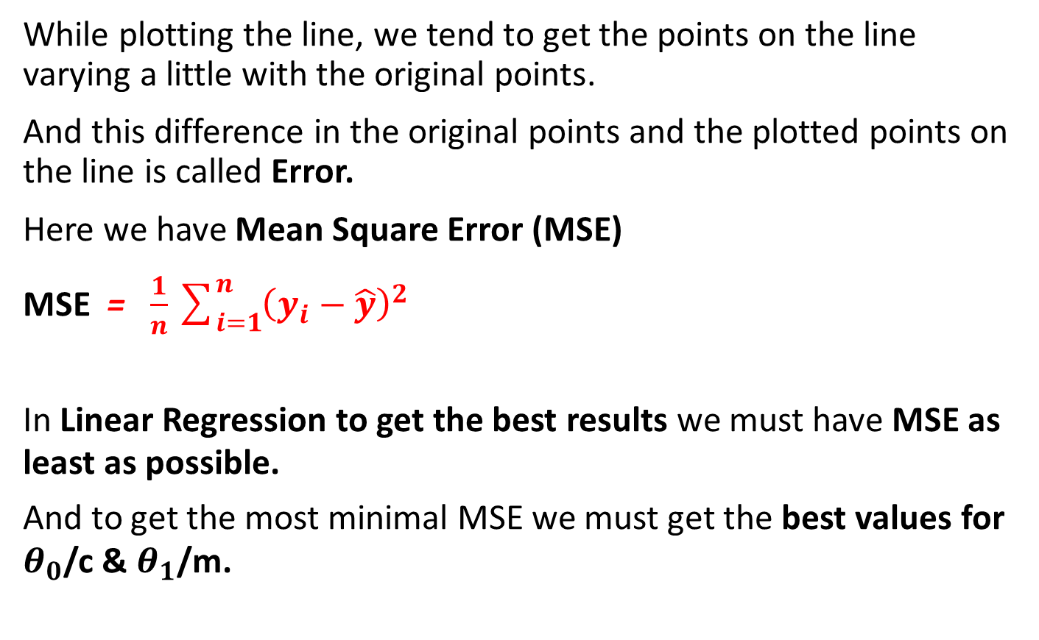
Errors
While plotting the line, we tend to get the points on the line varying a little with the original points.
And this difference in the original points and the plotted points on the line is called Error.
Here we have Mean Square Error (MSE)
MSE = $\frac{1}{n}\sum_{i=1}^{n}{{\left(y_{i}−\hat{y}\right)}^{2}}$
In Linear Regression to get the best results we must have MSE as least as possible.
And to get the most minimal MSE we must get the best values for $θ_{0}$/c & $θ_{1}$/m.

Slide 12
Linear Regression Graph

Slide 13
Model Evaluation Approaches
Model Evaluation Techniques
Holdout
Cross Validation

Slide 14
Holdout
Dataset is generally divided into Training Set and Test Set:
Training Dataset: This is the sample of data through which the Model learns and generalizes. Usually Training Dataset is 80% of the whole Dataset. The model is built on the Training Dataset.
Validation Set: This is used just for fine tuning the Model using hyperparameters. (Not necessary)
Test Dataset: This is the sample of data used for testing purposes of the trained model, to provide an unbiased evaluation of a final model. Generally the Test Dataset is 20% of the whole Dataset.

Slide 15
Training Accuracy:
The number of correct predictions the model has made in the testing of the same trained dataset.
A highly trained accuracy may result in an Over-Fit Model
Over-Fit Model – The model is over trained which may capture noise and produce a non-generalized model.
Out-of-Sample Accuracy:
The number of correct predictions the model makes on the data the model has not been trained on.

Slide 16
Thank - You
Don’t forget to Like, Share and Subscribe !!!

